Slide 1
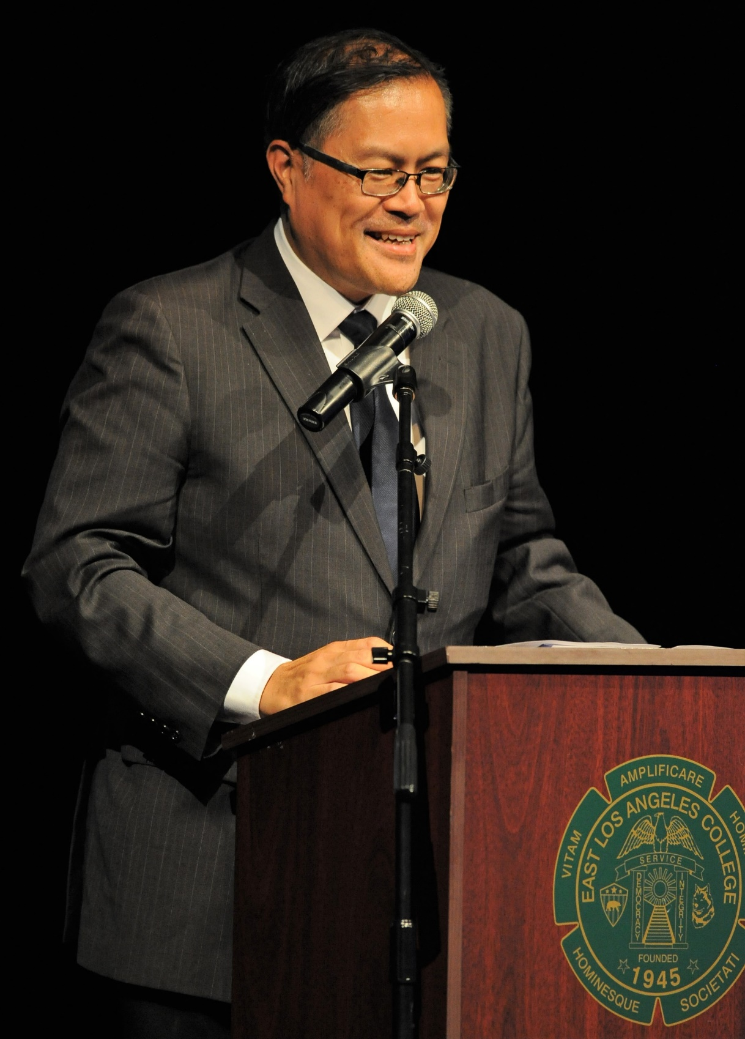
Assembly Higher Education Committee Oversight Hearing Dual Enrollment
Sonya Christian, Chancellor
California Community Colleges

Slide 2
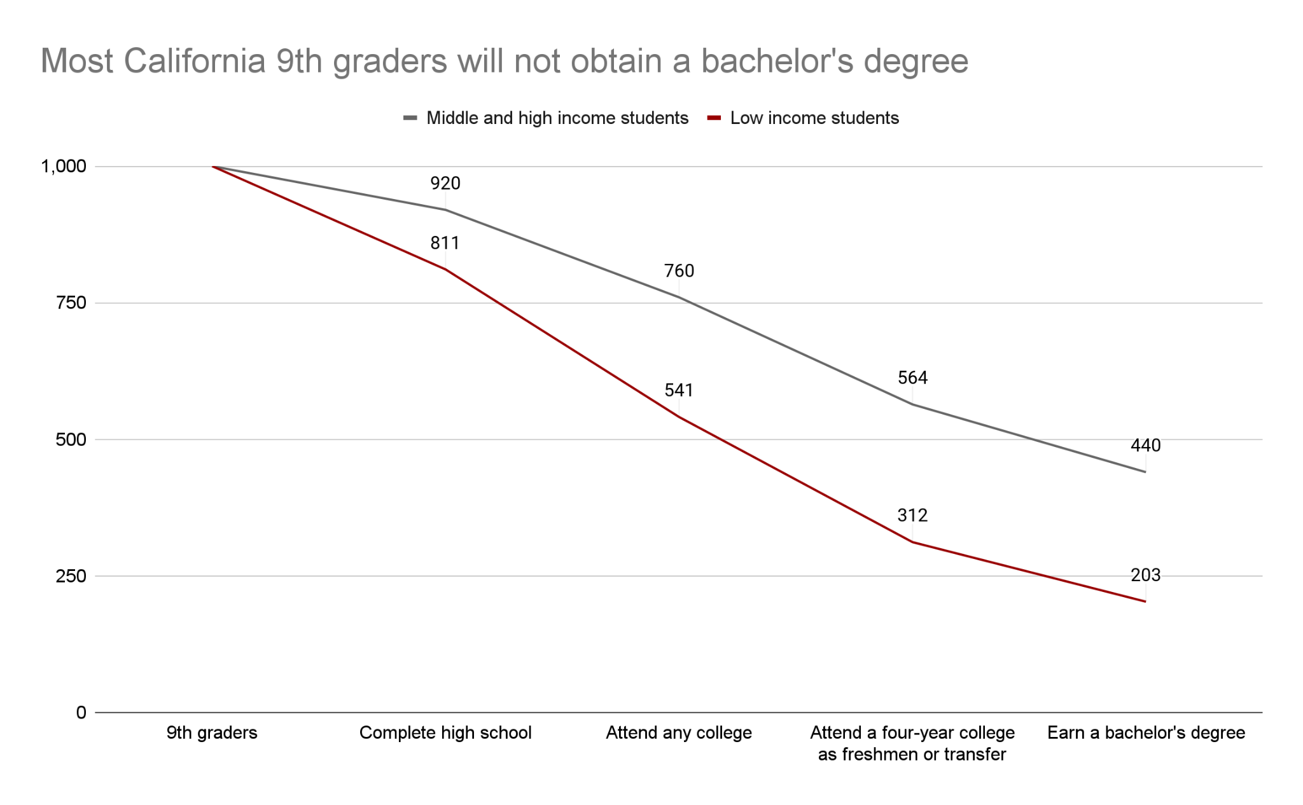
PPIC Report November 2020. Higher Education and Economic Opportunity in California.
https://www.ppic.org/wp-content/uploads/higher-education-and-economic-opportunity-in-california-november-2020.pdf

Slide 3
For every 1,000 ninth graders…
…518 Asian students will earn a bachelor’s degree.
…375 White students will earn a bachelor’s degree.
…181 Latino students will earn a bachelor’s degree.
…172 African American students will earn a bachelor’s degree.
PPIC Report November 2020. Higher Education and Economic Opportunity in California.
https://www.ppic.org/wp-content/uploads/higher-education-and-economic-opportunity-in-california-november-2020.pdf

Slide 4
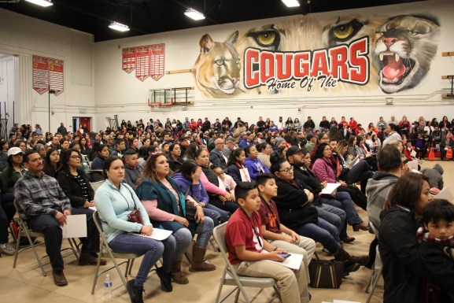
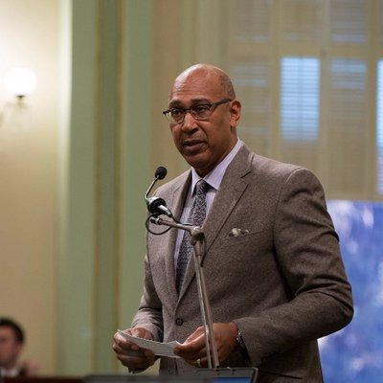
McFarland High School

Slide 5
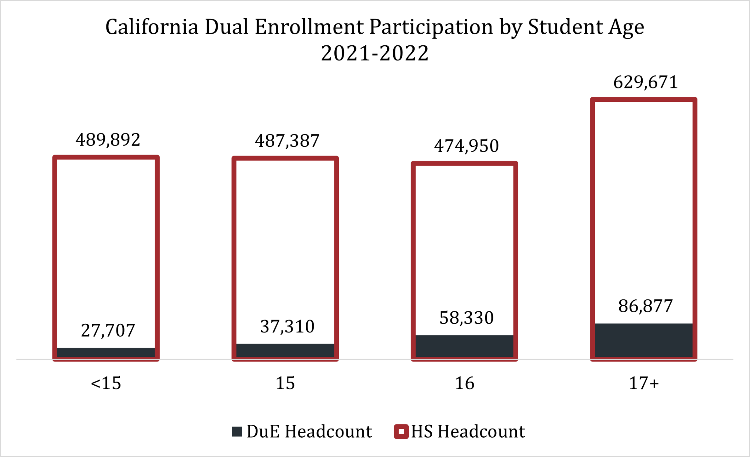
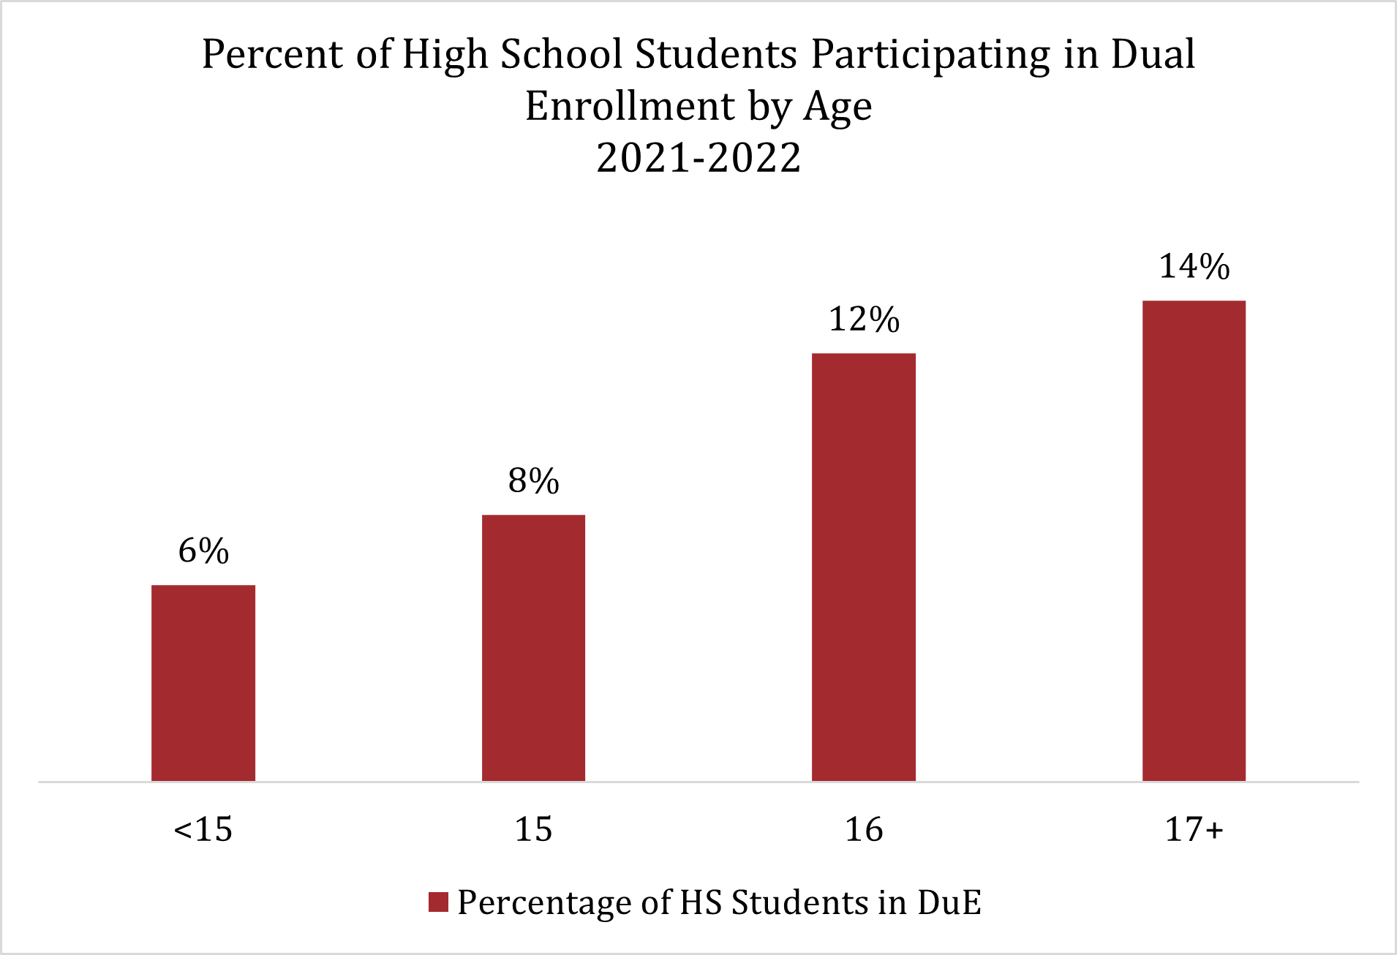
Statewide Dual Enrollment Reach by Age

